Slide 1


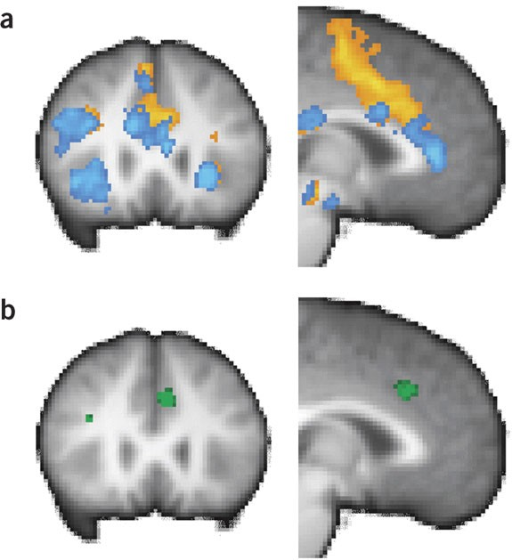
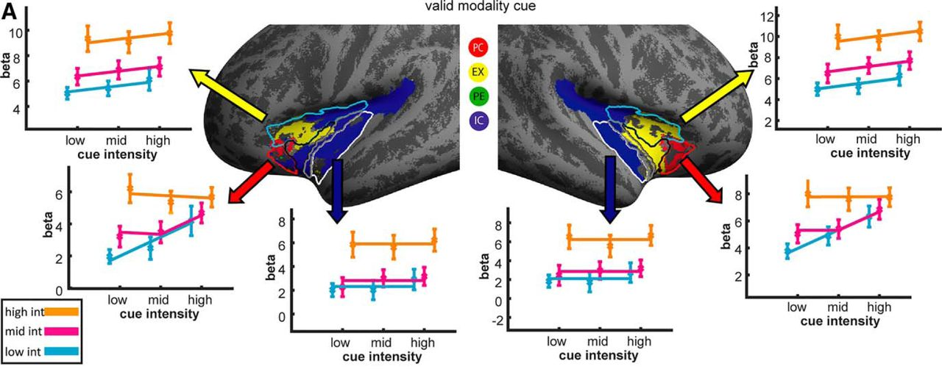
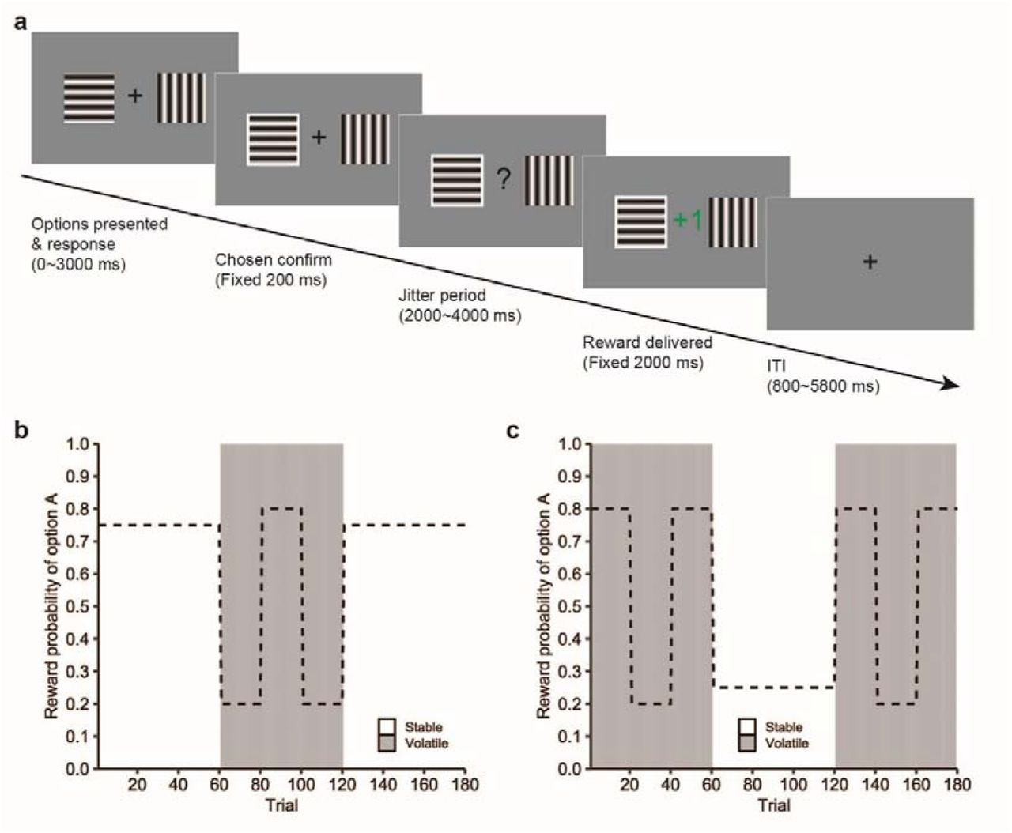
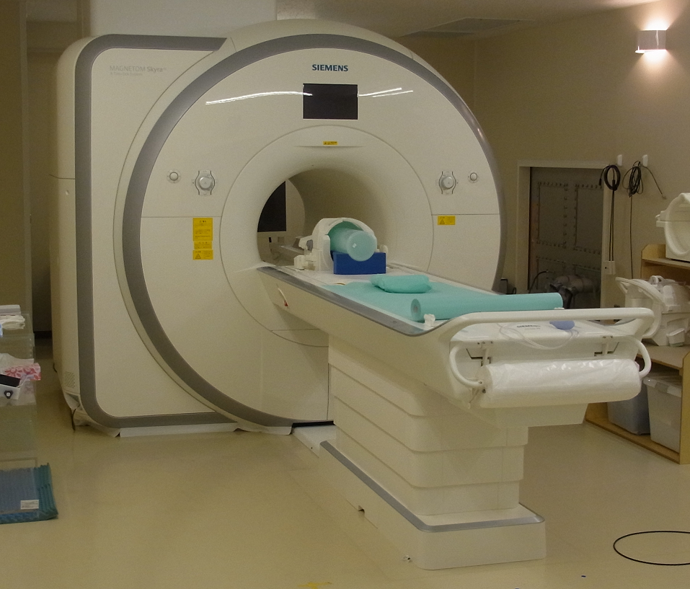

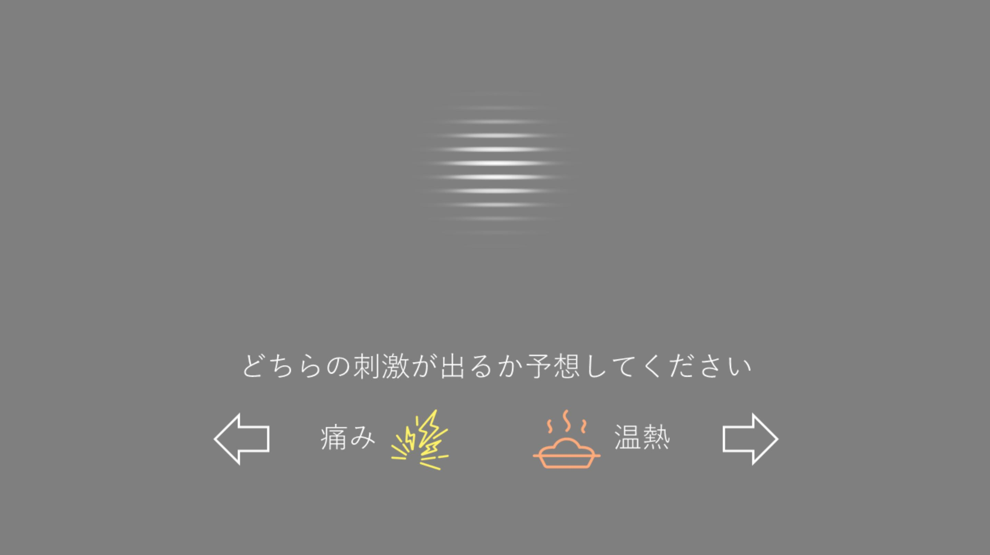
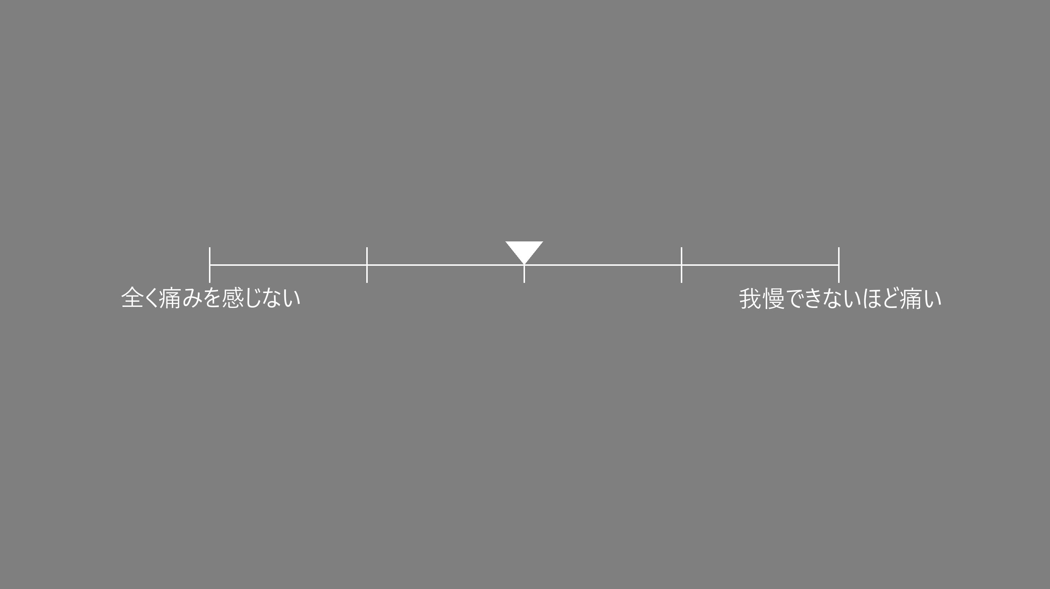
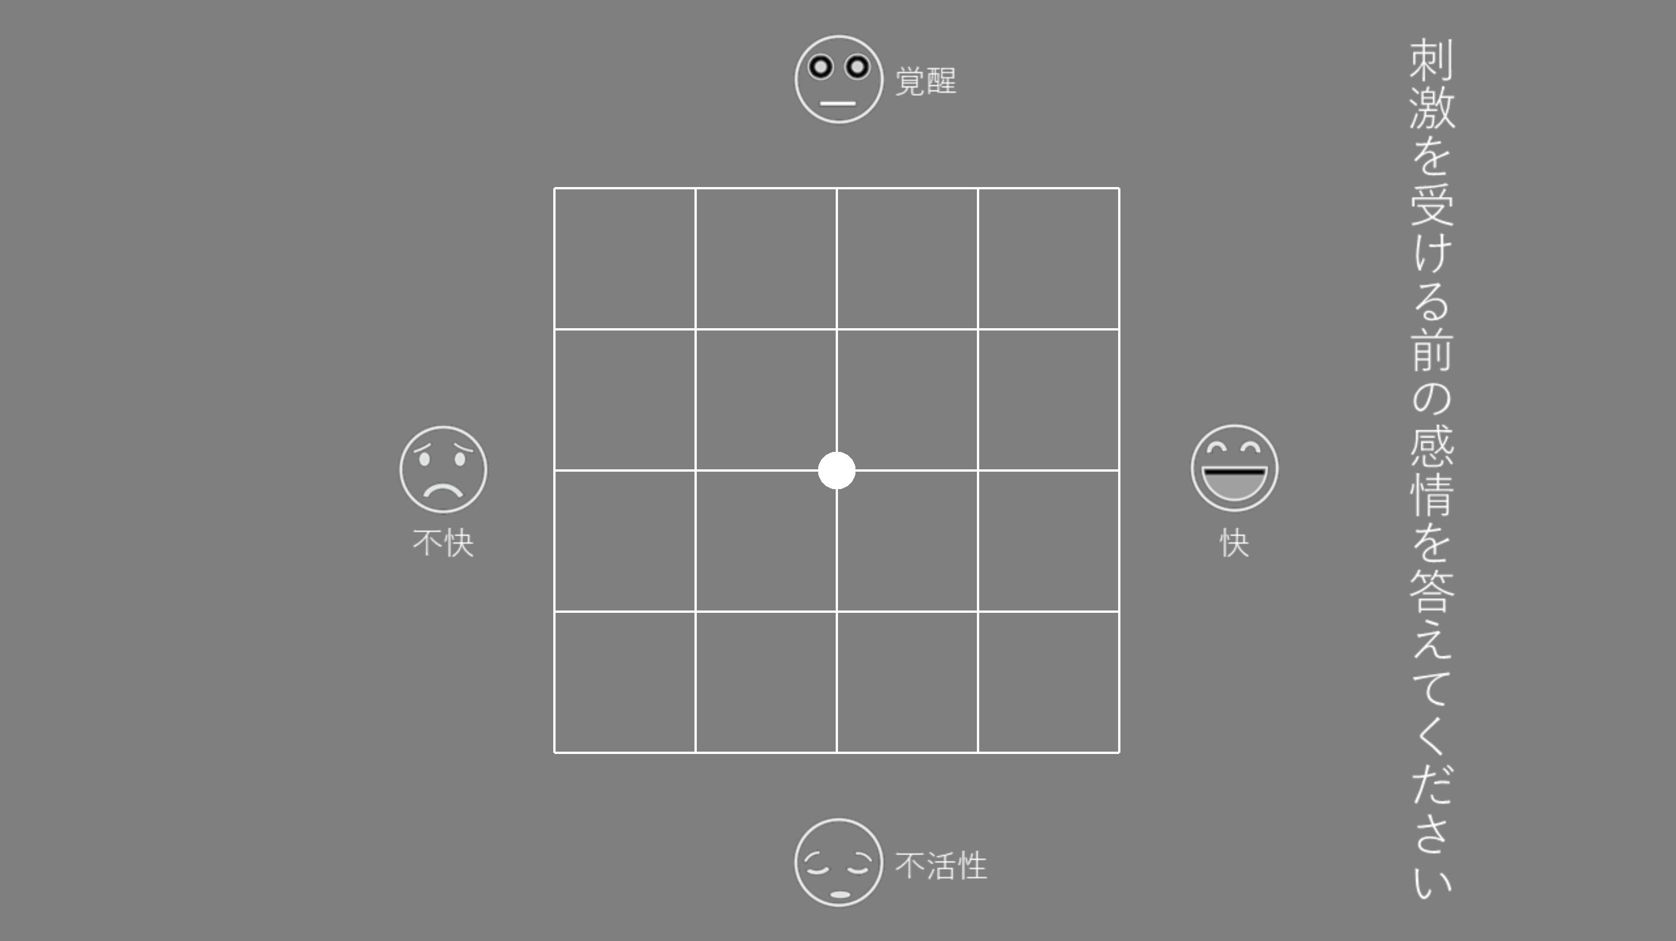
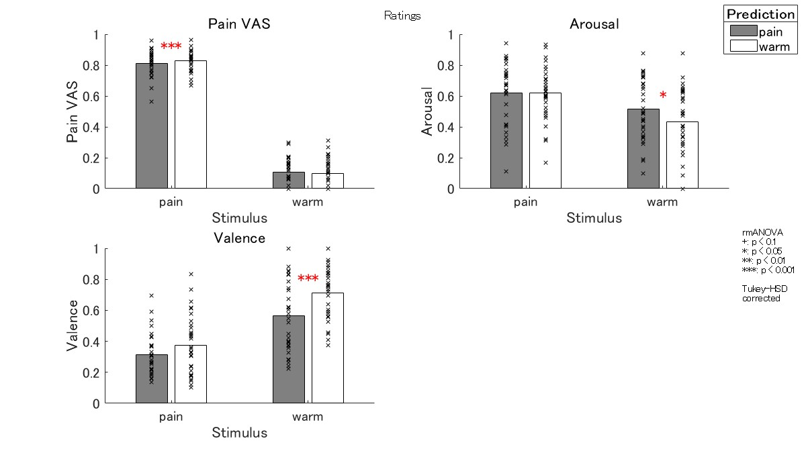
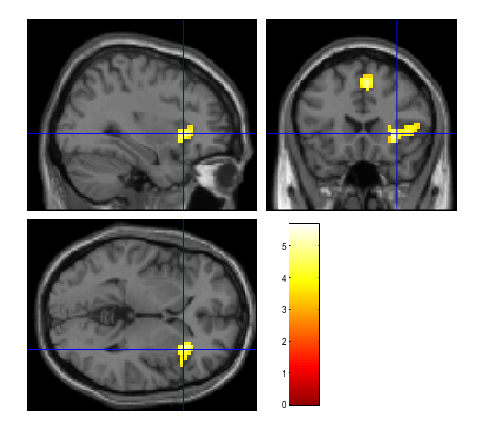
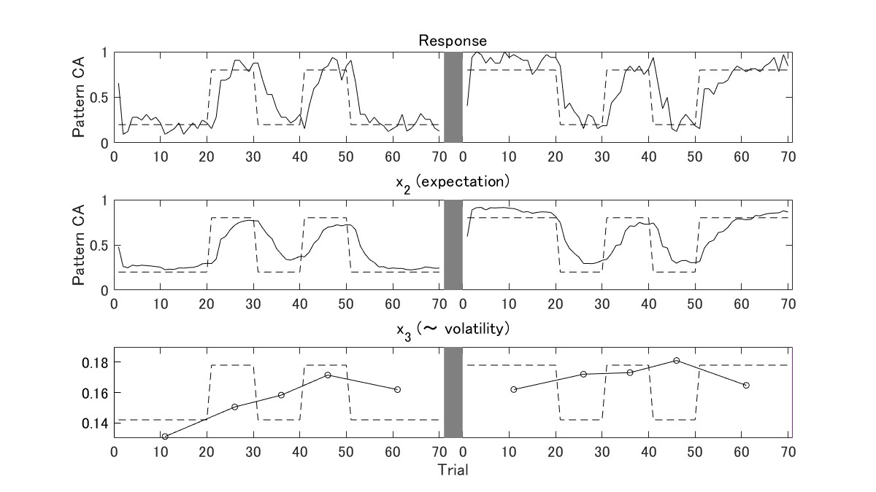
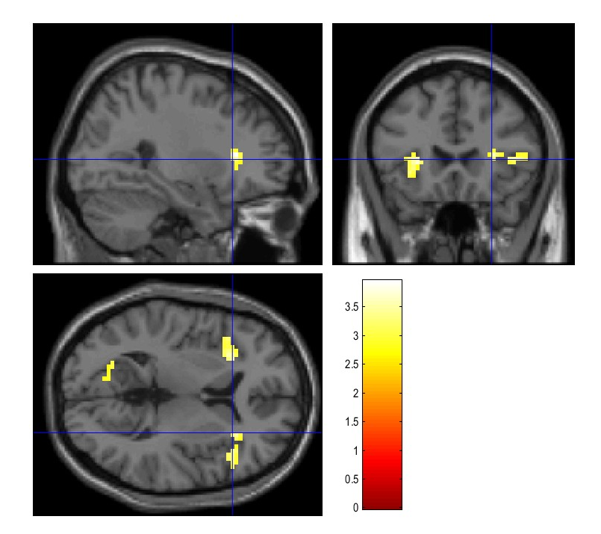
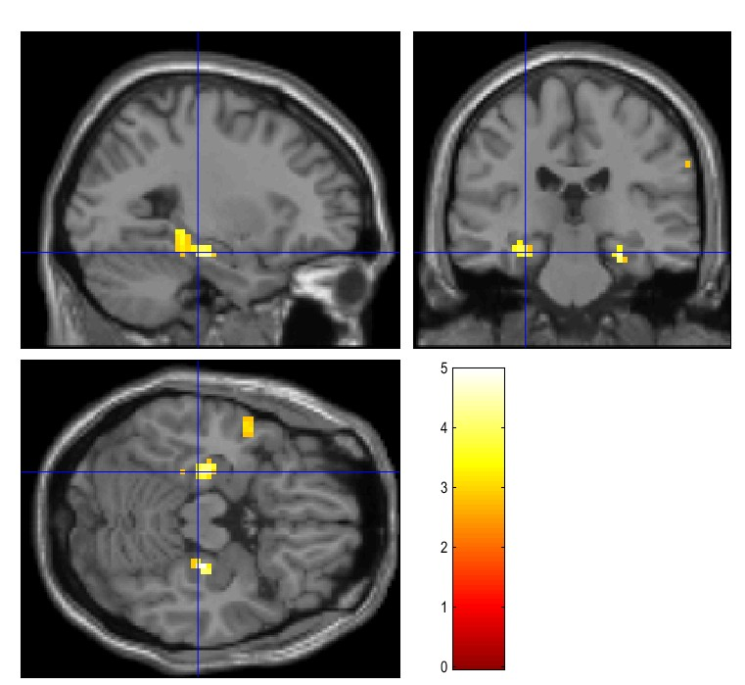
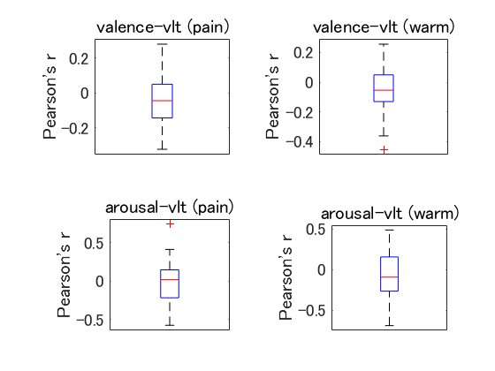
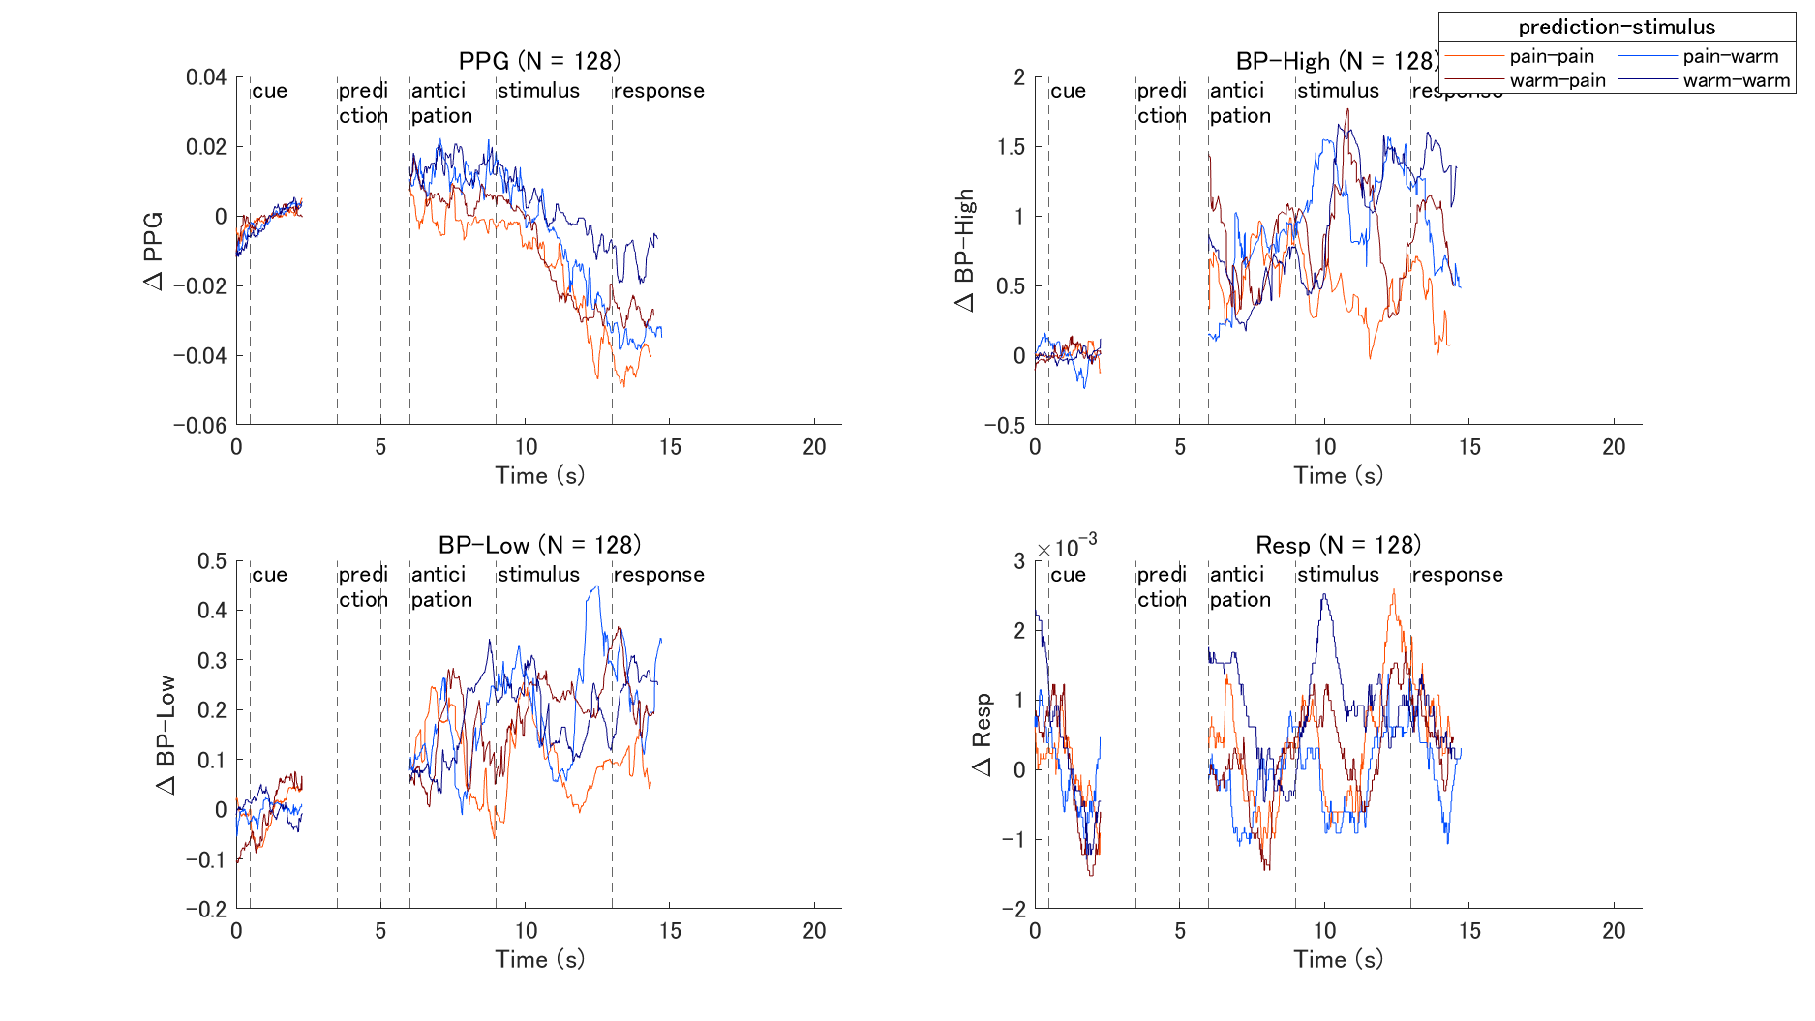
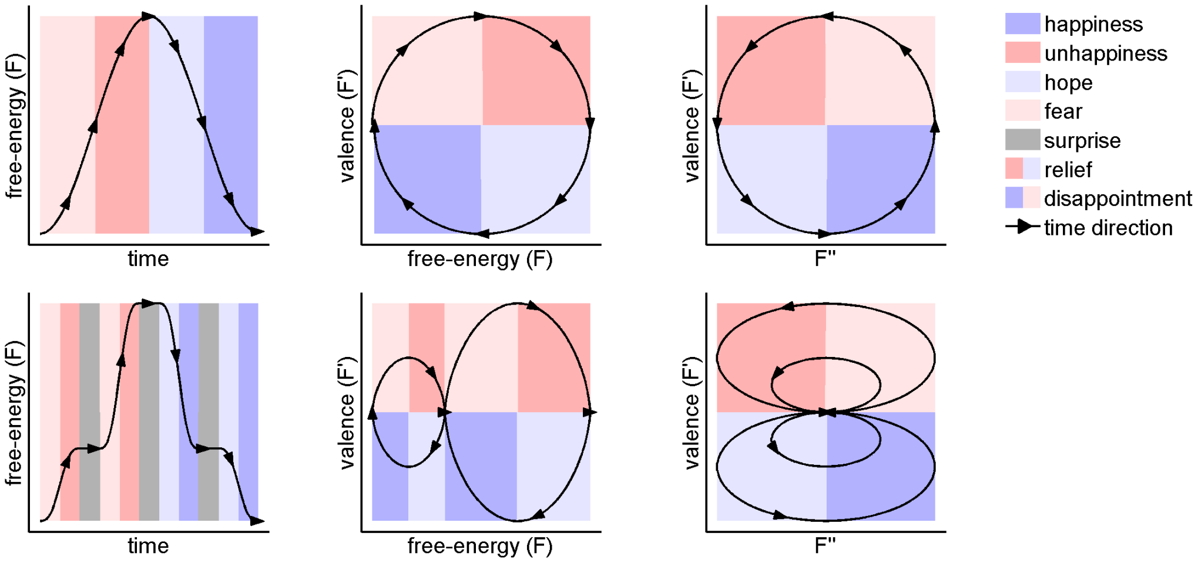
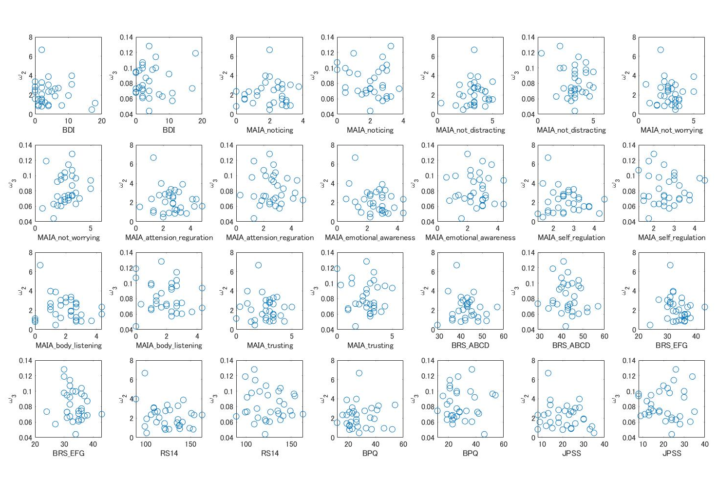
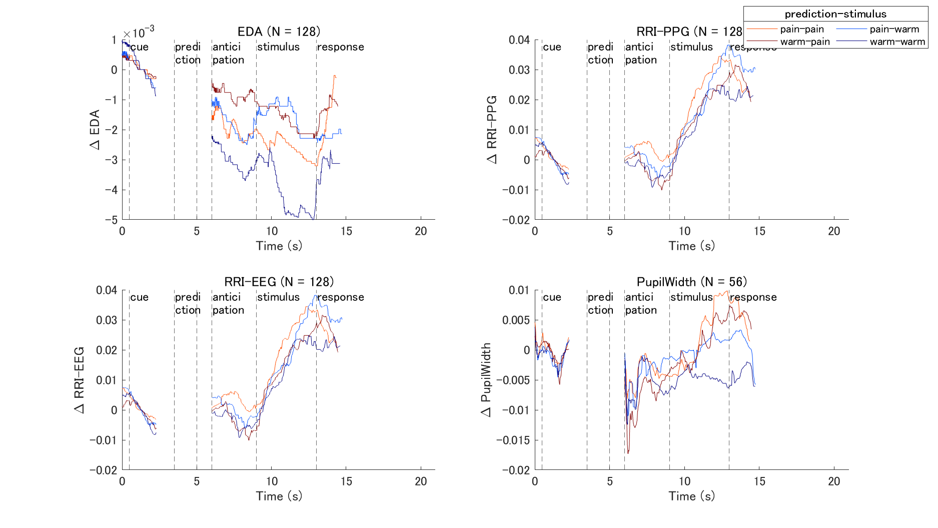
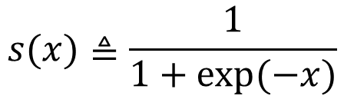
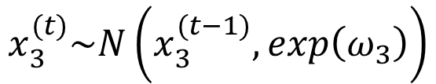
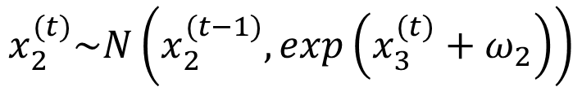

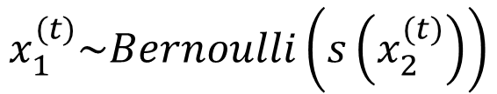
痛み予測のボラティリティと関連する前島の活動
Anterior insular cortex activity associated with volatility in pain prediction.
前川亮，笹岡貴史，吉野敦雄，山脇成人
Toru Maekawa, Takafumi Sasaoka, Atsuo Yoshino, Shigeto Yamawaki
広島大学，脳・こころ・感性科学研究センター（Hiroshima University, BMK center）
Introduction
Volatility
Pain prediction
In the reinforcement learning paradigm, volatility refers to the stability of the probability that a reward will be associated with a cue.
Stable conditions
Participants must adapt slowly to reduce the effects of noise and to achieve stable behavior.
Volatile conditions
Participants should quickly adapt to continuous changes in the environment.
Pain perception
⇒ posterior insula Pain prediction
⇒ anterior insula
Behrens et al. (2007)
Purpose
Fazeli & Büchel (2018)
Xu et al. (2021)
Stable ⇒ low learning rate
Volatile ⇒ high learning rate
Rewards × volatility interaction revealed activation in the ACC (green)
To examine brain activity related to volatility when pain is used as a stimulus.
Methods
Conditions
Procedure
Learning model
Cue
A (Gabor 0°)
B (Gabor 90°)
Heat stimuli
Pain（48℃）
Warm（35℃）
Cue-stim probability
A⇒P:80%, W:20% B⇒P:20%, W:80%
A⇒P:20%, W:80% B⇒P:80%, W:20%
Volatility
Volatile: probabilities switched every 10 trials
Stable: same probability lasts for 20 trials
Physiological measures
PPG, Blood pressure, EDA, respiration, pupil size
Questionnaire
MAIA, BDI, BRS, BPQ, JPSS
x₃
ω₃
Learning rate and subjective volatility of each participant were estimated from their prediction responses using Bayesian hierarchical estimation.
x₂
ω₂
1.0s
0.5s
3.0s
~1.0s
3.0s
5.0s
~2.5s
~3.5s
x₁
1.0
Fixation
1.5
Cue
4.5
2AFC
5.5
Anticipation
Stimulus
Pain VAS
Affective grid
$$x_{3}^{(t)}\sim N\left(x_{3}^{(t−1)},exp\left(ω_{3}\right)\right)$$
Volatility
①
②
①
8.5
12.5
15.0
18.5
$$x_{2}^{(t)}\sim N\left(x_{2}^{(t−1)},exp\left(x_{3}^{(t)}+ω_{2}\right)\right)$$
Probability of pain
②
①
$$x_{1}^{(t)}\sim Bernoulli\left(s\left(x_{2}^{(t)}\right)\right)$$
$$s(x)≜\frac{1}{1+exp⁡(−x)}$$
Response
Volatility
Stable
Volatile
Stable
Ref. Lawson et al., 2017
実験条件
Behavioral results
fMRI results
Subjective rating
Activities associated with volatility analyzed by the parametric modulation
Pain perception (pain stimulation)
Warm prediction > Pain prediction
Arousal (warm stimulation)
Pain prediction > warm prediction
Valence (warm stimulation)
Warm prediction > Pain prediction
SMC
$$volatility≜x_{2}\left(1−x_{2}\right)∙exp\left(x_{3}\right)$$
Anterior
insula
1.0s
0.5s
3.0s
~1.0s
3.0s
4.0s
~2.5s
~3.5s
1.0
fixation
1.5
Cue
4.5
2AFC
5.5
Antici-
pation
8.5
Stim
12.5
Pain
VAS
Affective
grid
15.0
18.5
Volatility model parameter estimation
uncorr. p < 0.001
at peak level
FWE p < 0.05
at cluster level
x₃
ω₃
Positive activity
Negative activity
x₂
ω₂
Anterior
insula
Para-
hippocampal
x₁
Estimate volatility parameters (x₂, x₃, ω₂, ω₃) for each participant based on prediction responses.
Correlations between other indicators
uncorr. p < 0.005
at peak level
FWE p < 0.05
at cluster level
Discussion
In the warm stimulus condition, valence was higher in warm predicted trials than in pain predicted trials.
Decreased free-energy was associated with better valence.
Joffily & Coricelli (2013)
Volatility estimates for the anticipatory period were associated with activity in the anterior insula.
Pain-related volatility is processed in anterior insula, not ACC.
Negative correlations with volatility (positive correlations with stability) were associated with activity in the parahippocampal gyrus.
Parahippocampal plays important role in memory encoding and retrieval (Brian et al., 1997).
In stable condition, participants have a stronger encoding of cues that is later recalled.
No significant correlation found between volatility parameters and emotion ratings, physiological measurements, and questionnaires
Research funds: JST COI (grant nos. JPMJCE1311 and JPMJCA2208), JST Moonshot Research and Development Program (grant no. JPMJMS2296)
Disclosure of Conflict of Interest: Authors have no COI with regard to the presentation

